Slide 1
Greek/latin Roots in Enlish
Why should we care?
“It’s all Greek to me!”

Slide 2
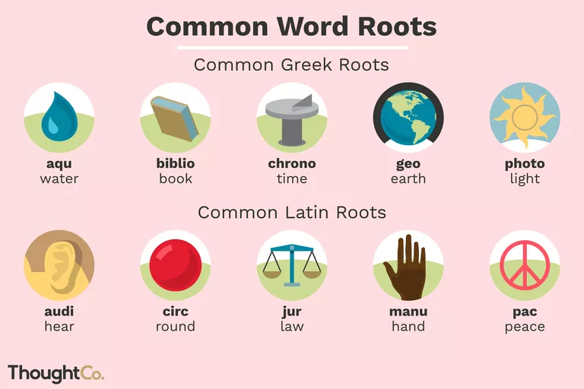
What are greek/latin root words?
Most words in the English language are based on words from ancient Greek and Latin.
In English grammar, a root is a word or portion of a word from which other words grow, usually through the addition of prefixes and suffixes.
By learning root words, you can decipher unfamiliar words, expand your vocabulary, and become a better English speaker.

Slide 3
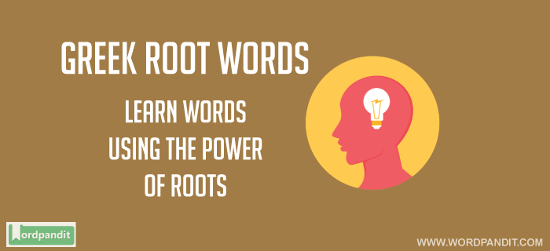
Why is it important to know Root words?
If you understand that any time you see the root, theo-, you're going to be dealing with "god" in some form, you'd know that words like theocracy, theology, atheist, polytheistic, and others all have something to do with a deity even if you've never seen or heard those words before. This also helps while learning new languages!
Knowing one root can multiply your vocabulary in an instant. Use this link for some examples! 120 Greek Roots

Slide 4
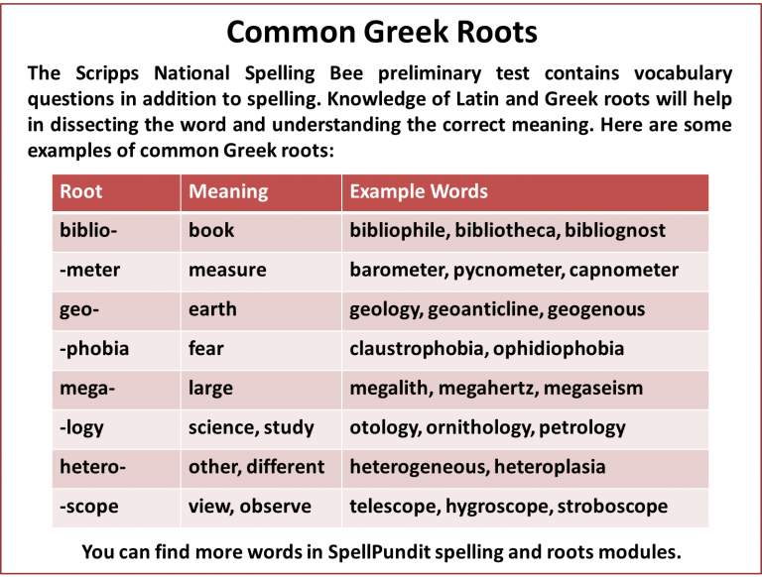

Slide 5
Reasons for greek/latin words study
Greek and Latin roots are not always the most fun to memorize or study, but they pay off in a big way! When you understand the roots behind the vocabulary we use in everyday language you have a step up on vocabulary comprehension that many others do not have!
1.Know one root, know many words
Example: theo = god
Now even if you have not seen a word before you can identify what it might mean by its root
theology, atheist, polytheistic

Slide 6
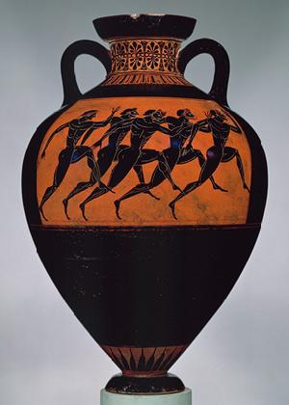
2. Suffixes can tell you part of speech
Example Suffix: -ist
Definition: a person who…
“ist is a noun that refers to a person’s job, ability or tendencies.
-cyclist: a person who cycles
-guitarist: a person who plays guitar
Knowing one suffix, or the word ending can
often give you the part of speech of a word,
which can help you know how to use it in a
sentence.

Slide 7
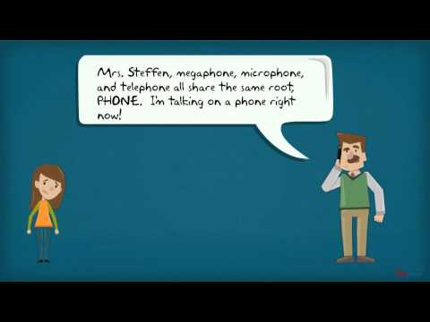
3. Know a Prefix, know part of the definition
Example Prefix Root: a-, an-
Definition: without, not
Amoral = without morals
Anhydrous = without water
Atypical = not typical
Knowing the prefix, or the word beginning can help you understand
part of the word, which is really helpful on a multiple choice vocabulary test.

Slide 8
4. Know your roots for future tests!
It may seem a long way off, but the SAT, ACT, GRE, and every major standardized test will have vocabulary you have not seen. By using Greek/Latin roots you can figure out the definition even without seeing it!
60% of English has Greek/Latin roots, 90% for the sciences (example-- “logy” = the study of
Biology, Zoology, Geology
Know one root, know 50 words!
Video: Greek and Latin Root Words
Latin and Greek roots make it easier to learn new languages!

Slide 9

Examples:
Somnambulist
som = sleep
ambul = walk
ist = a person who

Slide 10
Examples:
cosmology
Cosmo = Universe
Ology = The study of
Kleptomania
Klepto = Steal
Mania = obsession; excessive enthusiasm or desire

